Slide 1
INTRODUCTION TO GIT
NEEHARIKA

Slide 2
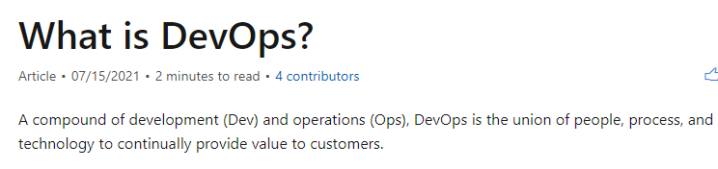

Slide 3
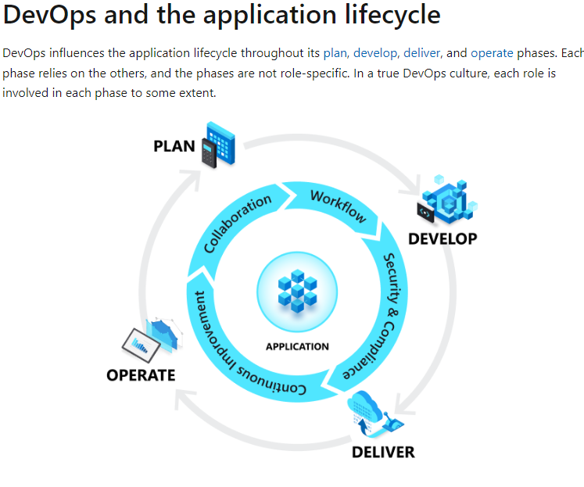

Slide 4
GIT
Git (/ɡɪt/)^{[7]} is software for tracking changes in any set of files, usually used for coordinating work among programmers collaboratively developing source code during software development. Its goals include speed, data integrity, and support for distributed, non-linear workflows (thousands of parallel branches running on different systems).^{[8][9][10]}
GIT

Slide 5
What is Git?
Git is a popular version control system. It was created by Linus Torvalds in 2005, and has been maintained by Junio Hamano since then.
It is used for:
Tracking code changes
Tracking who made changes
Coding collaboration
What does Git do?
Manage projects with Repositories
Clone a project to work on a local copy
Control and track changes with Staging and Committing
Branch and Merge to allow for work on different parts and versions of a project
Pull the latest version of the project to a local copy
Push local updates to the main project

Slide 6
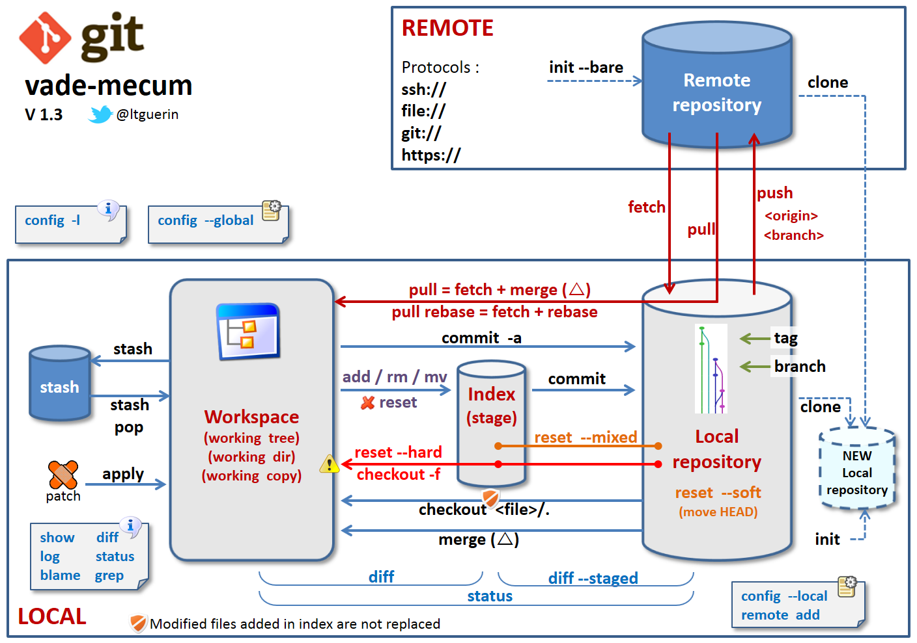

Slide 7
Working with Git
Initialize Git on a folder, making it a Repository
Git now creates a hidden folder to keep track of changes in that folder
When a file is changed, added or deleted, it is considered modified
You select the modified files you want to Stage
The Staged files are Committed, which prompts Git to store a permanent snapshot of the files
Git allows you to see the full history of every commit.
You can revert back to any previous commit.
Git does not store a separate copy of every file in every commit, but keeps track of changes made in each commit!

Slide 8

Git Install
You can download Git for free from the following website: https://www.git-scm.com/
Using Git with Command Line
To start using Git, we are first going to open up our Command shell.
For Windows, you can use Git bash, which comes included in Git for Windows. For Mac and Linux you can use the built-in terminal.
The first thing we need to do, is to check if Git is properly installed:

Slide 9
Example
git --version
git version 2.30.2.windows.1
If Git is installed, it should show something like git version X.Y
Configure Git
Now let Git know who you are. This is important for version control systems, as each Git commit uses this information:

Slide 10
Example
git config --global user.name "w3schools-test"
git config --global user.email "test@w3schools.com"
Note : Use global to set the username and e-mail for every repository on your computer.
If you want to set the username/e-mail for just the current repo, you can remove global

Slide 11
Creating Git Folder
Now, let's create a new folder for our project:
Example:
[USER@LOCALHOST]$ mkdir myproject
cd myproject
mkdir makes a new directory.
cd changes the current working directory.
Now that we are in the correct directory. We can start by initializing Git!
Note: If you already have a folder/directory you would like to use for Git:
Navigate to it in command line, or open it in your file explorer, right-click and select "Git Bash here"

Slide 12
Initialize Git
Once you have navigated to the correct folder, you can initialize Git on that folder:
Example:
[USER@LOCALHOST]$ git init
Initialized empty Git repository in /Users/user/myproject/.git/
You just created your first Git Repository!
Note: Git now knows that it should watch the folder you initiated it on.
Git creates a hidden folder to keep track of changes.

Slide 13
What is a Git Repository?
The purpose of Git is to manage a project, or a set of files, as they change over time. Git stores this information in a data structure called a repository. In short Git Repository is a collection of all project files along with their history. It is a virtual storage of your project where you keep all the resources/files of the project along with a special folder called .git. The .git folder in a git repository is used by GIT programs to store information about the repository like Logs, Position of Head, and more. It allows you to save versions of your code, which can be accessed, tracked, and managed.
At this article, we don't know much about these terms and hence we will keep our discussion to a minimum about the .git folder. For the time being, just remember that every GIT repository will have a hidden .git folder to enable GIT programs to track changes in the repository.

Slide 14
Different ways to Create Git Repository
We can Create Git Repository using one of the three approaches enlisted below:
Create a bare repository
Initialize repository in an existing project directory
Clone a remote repository from Github

Slide 15
Installing Git on Windows
Create a Bare Git Repository
Creating a Bare Git Repository for a new project is three-step process:
Create a New Project/Folder
Browse to New Project
Initialize Git Repository for the Project
Once you have Git installed, simply search of git cmd in your system search bar. You will get the Command line tool listed as shown in the below image.

Slide 16
Step 1: Create a New Project/Folder - Now that we have our command line tool open, let us create a project folder. Creating a project folder with a good name is very important. If you have a Good and Relevant name of your project it will become easier for you to identify and relate to the project when you come back to it in the future.

Slide 17

Command to create a folder on a Windows and Mac system is mkdir <folderName>. Where folder name is the project name. Let us name our first project LocalGit. With this name, the command becomes: mkdir LocalGit

Slide 18
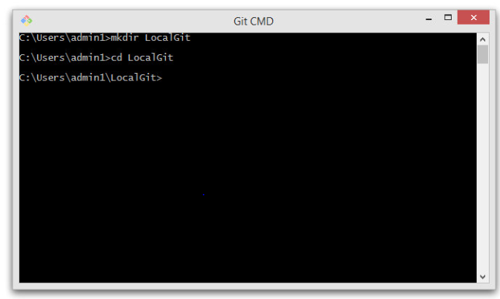
Navigate to this folder by using the command cd LocalGit, both on Windows and Mac systems.
Now you are inside the repository folder

Slide 19
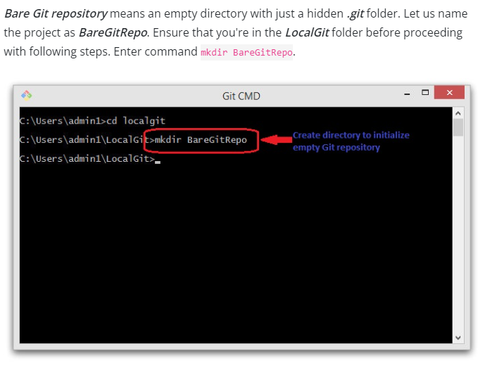

Slide 20
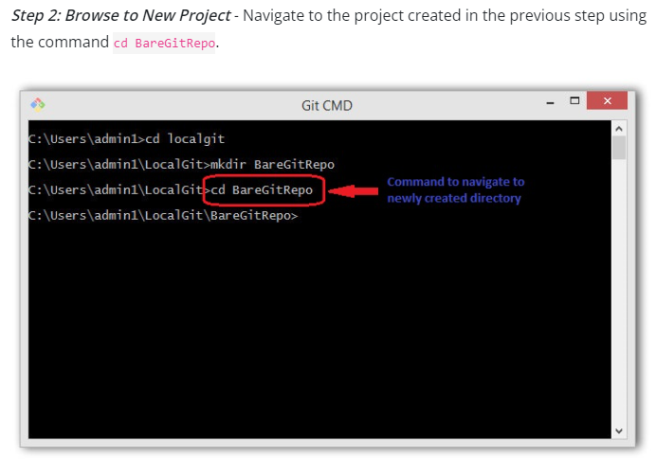

Slide 21
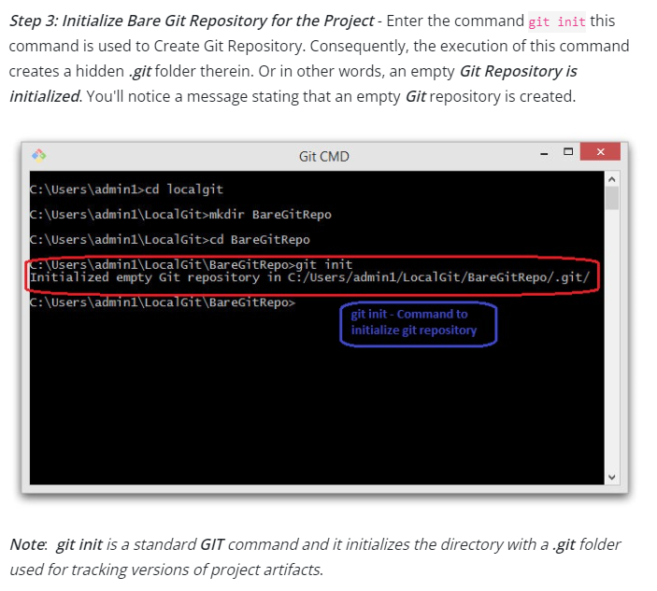

Slide 22
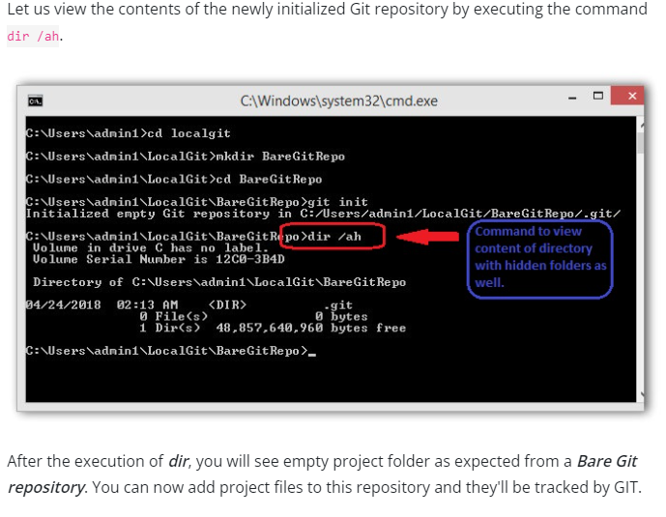

Slide 23
Git New Files
Git Adding New Files
You just created your first local Git repo. But it is empty.
So let's add some files, or create a new file using your favourite text editor. Then save or move it to the folder you just created.
If you want to learn how to create a new file using a text editor, you can visit our HTML tutorial:
HTML Editors
For this example, I am going to use a simple HTML file like this:

Slide 24
Example
<!DOCTYPE html>
<html>
<head>
<title>Hello World!</title>
</head>
<body>
<h1>Hello world!</h1>
<p>This is the first file in my new Git Repo.</p>
</body>
</html>
And save it to our new folder as index.html.

Slide 25
Let's go back to the terminal and list the files in our current working directory:
Example
[USER@LOCALHOST]$ ls index.html
ls will list the files in the directory. We can see that index.html is there.
Then we check the Git status and see if it is a part of our repo:

Slide 26
Example
[USER@LOCALHOST]$ git status
On branch master
No commits yet
Untracked files:
(use "git add ..." to include in what will be committed)
index.html
nothing added to commit but untracked files present (use "git add" to track)
Now Git is aware of the file, but has not added it to our repository!

Slide 27
Git Staging Environment
One of the core functions of Git is the concepts of the Staging Environment, and the Commit.
As you are working, you may be adding, editing and removing files. But whenever you hit a milestone or finish a part of the work, you should add the files to a Staging Environment.
Staged files are files that are ready to be committed to the repository you are working on. You will learn more about commit shortly.
For now, we are done working with index.html. So we can add it to the Staging Environment:
Example
[USER@LOCALHOST]$ git add index.html

Slide 28
The file should be Staged. Let's check the status::
Example
[USER@LOCALHOST]$ git status
On branch master
No commits yet
Changes to be committed:
(use "git rm --cached ..." to unstage)
new file: index.html
Now the file has been added to the Staging Environment.

Slide 29
Git Add More than One File
You can also stage more than one file at a time. Let's add 2 more files to our working folder. Use the text editor again.
A README.md file that describes the repository (recommended for all repositories):
Example
# hello-world
Hello World repository for Git tutorial
This is an example repository for the Git tutoial on https://www.w3schools.com
This repository is built step by step in the tutorial.

Slide 30
A basic external style sheet (bluestyle.css):
Example
body {
background-color: lightblue;
}
h1 {
color: navy;
margin-left: 20px;
}

Slide 31
And update index.html to include the stylesheet:
Example
<!DOCTYPE html>
<html>
<head>
<title>Hello World!</title>
<link rel="stylesheet" href="bluestyle.css">
</head>
<body>
<h1>Hello world!</h1>
<p>This is the first file in my new Git Repo.</p>
</body>
</html>

Slide 32
Now add all files in the current directory to the Staging Environment:
Example
[USER@LOCALHOST]$ git add --all
Using --all instead of individual filenames will stage all changes (new, modified, and deleted) files.

Slide 33
Example
[USER@LOCALHOST]$ git status
On branch master
No commits yet
Changes to be committed:
(use "git rm --cached ..." to unstage)
new file: README.md
new file: bluestyle.css
new file: index.html
Now all 3 files are added to the Staging Environment, and we are ready to do our first commit.
Note: The shorthand command for git add --all is git add -A

Slide 34
Git Commit
Since we have finished our work, we are ready move from stage to commit for our repo.
Adding commits keep track of our progress and changes as we work. Git considers each commit change point or "save point". It is a point in the project you can go back to if you find a bug, or want to make a change.
When we commit, we should always include a message.
By adding clear messages to each commit, it is easy for yourself (and others) to see what has changed and when.

Slide 35
Example
[USER@LOCALHOST]$ git commit -m "First release of Hello World!"
[master (root-commit) 221ec6e] First RELEASE OF HELLO
WORLD
3 files changed, 26 insertions(+)
create mode 100644 README.md
create mode 100644 bluestyle.css
create mode 100644 index.html
The commit command performs a commit, and the -m "message" adds a message.
The Staging Environment has been committed to our repo, with the message:
"First release of Hello World!"

Slide 36
Git Commit without Stage
Sometimes, when you make small changes, using the staging environment seems like a waste of time. It is possible to commit changes directly, skipping the staging environment. The -a option will automatically stage every changed, already tracked file.
Let's add a small update to index.html:

Slide 37
Example
<!DOCTYPE html>
<html>
<head>
<title>Hello World!</title>
<link rel="stylesheet" href="bluestyle.css">
</head>
<body>
<h1>Hello world!</h1>
<p>This is the first file in my new Git Repo.</p>
<p>A new line in our file!</p>
</body>
</html>

Slide 38
And check the status of our repository. But this time, we will use the --short option to see the changes in a more compact way:
Example
[USER@LOCALHOST]$ git status --short
M index.html
Note: Short status flags are:
?? - Untracked files
A - Files added to stage
M - Modified files
D - Deleted files

Slide 39
We see the file we expected is modified. So let's commit it directly:
Example
[USER@LOCALHOST]$ git commit -a -m "Updated Index.html with a new line"
[master 09f4acd] Updated index.html with a new line
1 file changed, 1 insertion(+)

Slide 40
Git Commit Log
To view the history of commits for a repository, you can use the log command:
Example
[user@localhost]$ git log
commit 09f4acd3f8836b7f6fc44ad9e012f82faf861803 (HEAD -> master)
Author: w3schools-test
Date: Fri Mar 26 09:35:54 2021 +0100
Updated index.html with a new line
commit 221ec6e10aeedbfd02b85264087cd9adc18e4b26
Author: w3schools-test
Date: Fri Mar 26 09:13:07 2021 +0100
First release of Hello World!

Slide 41
Git Branch
Working with Git Branches
In Git, a branch is a new/separate version of the main repository.
Let's say you have a large project, and you need to update the design on it.
How would that work without and with Git:

Slide 42
Without Git:
Make copies of all the relevant files to avoid impacting the live version
Start working with the design and find that code depend on code in other files, that also need to be changed!
Make copies of the dependant files as well. Making sure that every file dependency references the correct file name
EMERGENCY! There is an unrelated error somewhere else in the project that needs to be fixed ASAP!
Save all your files, making a note of the names of the copies you were working on
Work on the unrelated error and update the code to fix it
Go back to the design, and finish the work there
Copy the code or rename the files, so the updated design is on the live version
(2 weeks later, you realize that the unrelated error was not fixed in the new design version because you copied the files before the fix)

Slide 43
With Git:
With a new branch called new-design, edit the code directly without impacting the main branch
EMERGENCY! There is an unrelated error somewhere else in the project that needs to be fixed ASAP!
Create a new branch from the main project called small-error-fix
Fix the unrelated error and merge the small-error-fix branch with the main branch
You go back to the new-design branch, and finish the work there
Merge the new-design branch with main (getting alerted to the small error fix that you were missing)
Branches allow you to work on different parts of a project without impacting the main branch.
When the work is complete, a branch can be merged with the main project.
You can even switch between branches and work on different projects without them interfering with each other.
Branching in Git is very lightweight and fast!

Slide 44
New Git Branch
Let add some new features to our index.html page.
We are working in our local repository, and we do not want to disturb or possibly wreck the main project.
So we create a new branch:
Example
[user@localhost]$ git branch hello-world-images
Now we created a new branch called "hello-world-images"

Slide 45
Let's confirm that we have created a new branch:
Example
[usre@localhost]$ git branch
hello-world-images
* master
We can see the new branch with the name "hello-world-images", but the * beside master specifies that we are currently on that branch.

Slide 46
checkout is the command used to check out a branch. Moving us from the current branch, to the one specified at the end of the command:
Example
[user@localhost]$ git checkout hello-world-images
Switched to branch 'hello-world-images'
Now we have moved our current workspace from the master branch, to the new branch

Slide 47
Git Branch Merge
Merge Branches
We have the emergency fix ready, and so let's merge the master and emergency-fix branches.
First, we need to change to the master branch:
Example
[user@localhost] $ git checkout master
Switched to branch 'master'

Slide 48
Now we merge the current branch (master) with emergency-fix:
Example
[user@localhost] $ git merge emergency-fix
Updating 09f4acd..dfa79db
Fast-forward
index.html | 2 +-
1 file changed, 1 insertion(+), 1 deletion(-)
Since the emergency-fix branch came directly from master, and no other changes had been made to master while we were working, Git sees this as a continuation of master. So it can "Fast-forward", just pointing both master and emergency-fix to the same commit.

Slide 49
As master and emergency-fix are essentially the same now, we can delete emergency-fix, as it is no longer needed:
Example
[user@localhost] $ branch -d emergency-fix
Deleted branch emergency-fix (was dfa79db).

Slide 50
Merge Conflict
Now we can move over to hello-world-images and keep working. Add another image file (img_hello_git.jpg) and change index.html, so it shows it:
Example
[user@localhost] $ git checkout hello-world-images
Switched to branch 'hello-world-images'

Slide 51
Example
<!DOCTYPE html>
<html>
<head>
<title>Hello World!</title>
<link rel="stylesheet" href="bluestyle.css">
</head>
<body>
<h1>Hello world!</h1>
<div><img src="img_hello_world.jpg" alt="Hello World from Space" style="width:100%;max-width:960px"></div>
<p>This is the first file in my new Git Repo.</p>
<p>A new line in our file!</p>
<div><img src="img_hello_git.jpg" alt="Hello Git" style="width:100%;max-width:640px"></div>
</body>
</html>

Slide 52
Now, we are done with our work here and can stage and commit for this branch:
Example
[user$localhost] $ git add --all
git commit -m "added new image"
[hello-world-images 1f1584e] added new image
2 files changed, 1 insertion(+)
create mode 100644 img_hello_git.jpg
We see that index.html has been changed in both branches. Now we are ready to merge hello-world-images into master. But what will happen to the changes we recently made in master?

Slide 53
Example
[user@localhost] $ git checkout master
[user@localhost] $ git merge hello-world-images
Auto-merging index.html
CONFLICT (content): Merge conflict in index.html
Automatic merge failed; fix conflicts and then commit the result.
The merge failed, as there is conflict between the versions for index.html. Let us check the status:

Slide 54
Example
[user@localhost] $ git status
On branch master
You have unmerged paths.
(fix conflicts and run "git commit")
(use "git merge --abort" to abort the merge)
Changes to be committed:
new file: img_hello_git.jpg
new file: img_hello_world.jpg
Unmerged paths:
(use "git add ..." to mark resolution)
both modified: index.html
This confirms there is a conflict in index.html, but the image files are ready and stagedto be committed.

Slide 55
Git Ignore and .gitignore
Git Ignore
When sharing your code with others, there are often files or parts of your project, you do not want to share.
Examples
log files
temporary files
hidden files
personal files
etc.
Git can specify which files or parts of your project should be ignored by Git using a .gitignore file.
Git will not track files and folders specified in .gitignore. However, the .gitignore file itself IS tracked by Git.

Slide 56
Create .gitignore
To create a .gitignore file, go to the root of your local Git, and create it:
Example
[user@localhost] $ touch .gitignore

Slide 57
Now open the file using a text editor.
We are just going to add two simple rules:
Ignore any files with the .log extension
Ignore everything in any directory named temp
Example
# ignore ALL .log files
*.log
# ignore ALL files in ANY directory named temp
temp/
Now all .log files and anything in temp folders will be ignored by Git.
Note: In this case, we use a single .gitignore which applies to the entire repository.
It is also possible to have additional .gitignore files in subdirectories. These only apply to files or folders within that directory.

Slide 58
What is Git Alias?
Alias is a term associated with shortcuts in Git. It compresses the longer sequence of commands to a shorter sequence. It is always better to apply aliases to the frequently used longer commands since it helps in increasing efficiency. By longer commands, I mean longer patterns of commands, which include different options and flags, but it is not necessary for the command to be longer per se. Moreover, a user can create an alias for any command they want and thinks if that command will be used very frequently by them. It is noteworthy that there is no such command as "alias" that exists in Git. In other words, alias is just the term used to create a shorter command out of a longer sequence of commands. So, since there is no concept as an alias, where do we do all this? Where is all this stored?

Slide 59
Aliases happen in the Git Config file. To know more about the git config file and how it is viewed and edited in Git Bash, you can visit the Git-Config tutorial. So once you create an alias, you can either save it as a local copy for your repo or globally. The user doesn't need to use alias name only; the user is free to use the original command also. There are no restrictions. Let's see how to create an alias along with a few flags whose usage is quite frequent.

Slide 60
How To Create Aliases In Git?
Open your Git Bash in the working directory.
Type the following code and execute the command:
git config --global alias.hist "log --pretty=format:'%h %ad | %s%d [%an]' --graph --date=short"

Slide 61
git config --global = Config --Global tells the git to include the alias in the config file, or we are trying to edit the config file. The global keyword stores the alias globally.
alias.hist = alias is the keyword telling the git that the word following it will act as the alias. "hist" is the word we will be using here.
"log --pretty=format: '%h %ad | %s%d [%an]' --graph --date=short" = This is the actual command of which we will be creating an alias of. So, in the above screenshot, we are trying to create a shorter command for "log --pretty=format: '%h %ad | %s%d [%an]' --graph --date=short".

Slide 62
In the next steps, we will try out our newly created alias name to use in Git bash.
Type git hist now to see if the alias works:
Execute the command by pressing enter.

Slide 63
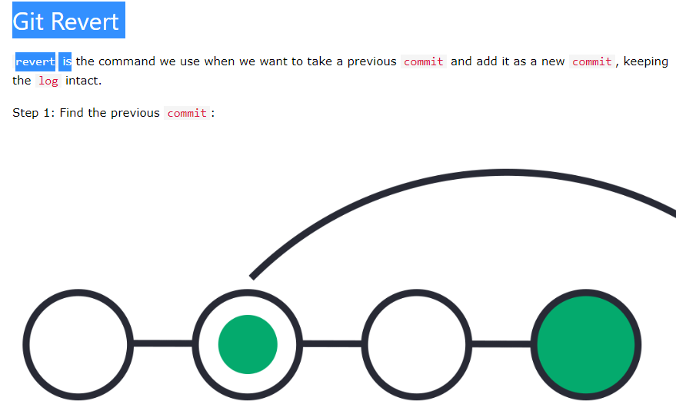

Slide 64
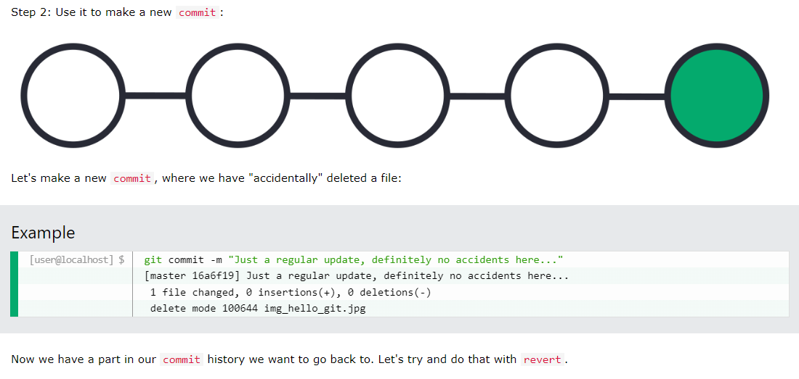

Slide 65
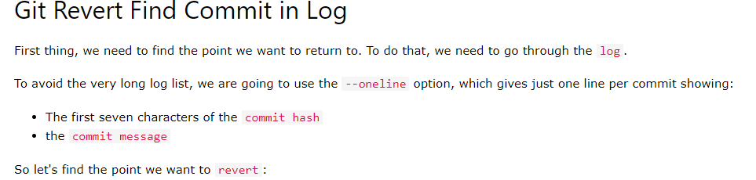

Slide 66
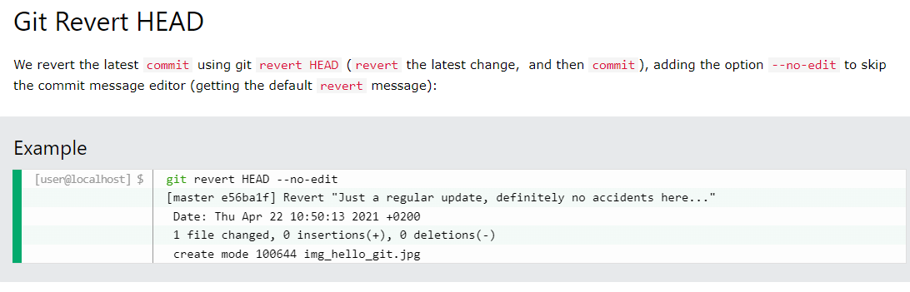

Slide 67
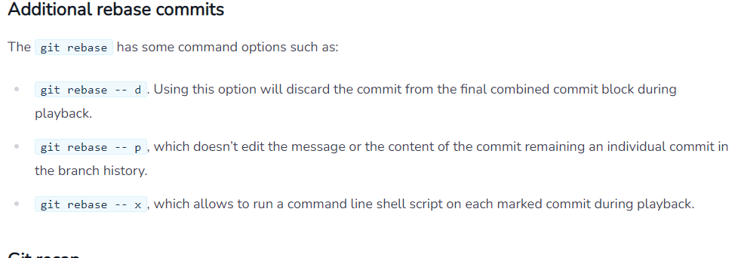

Slide 68
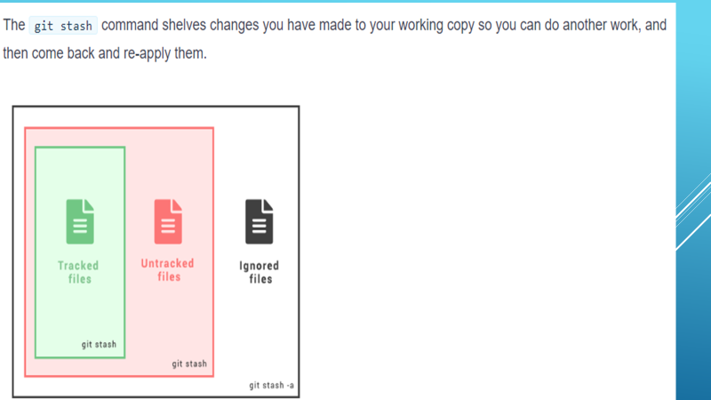

Slide 69
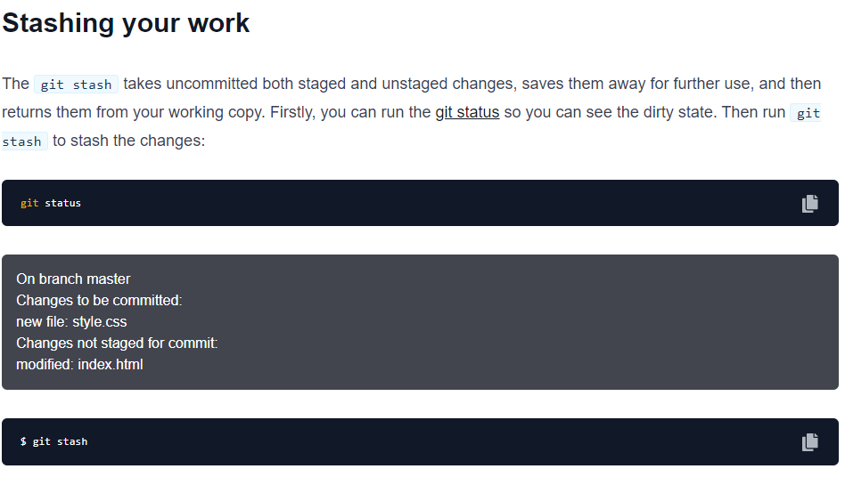

Slide 70
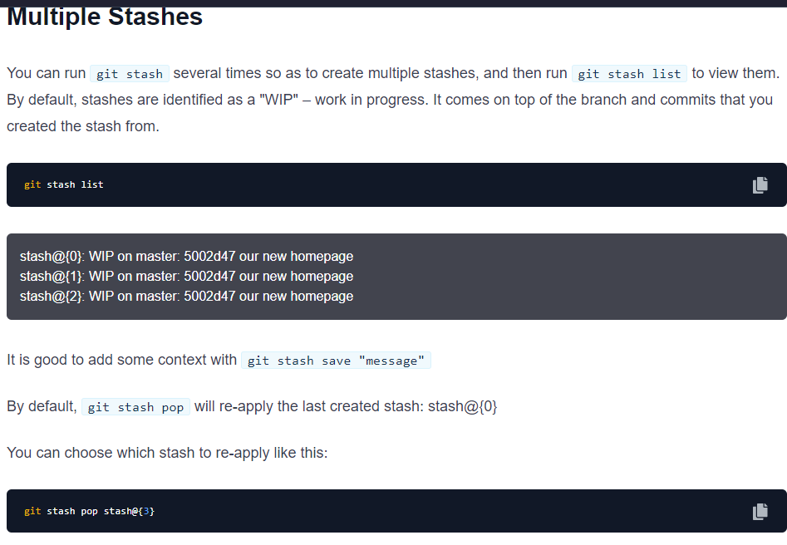

Slide 71
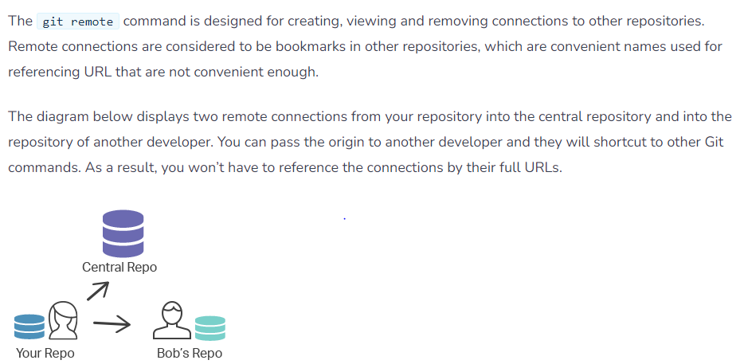

Slide 72
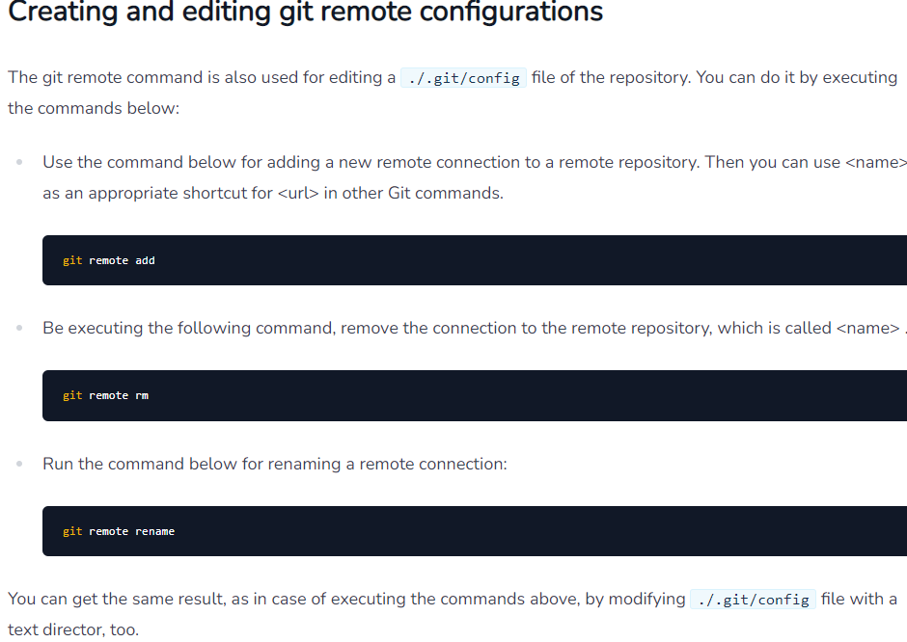

Slide 73
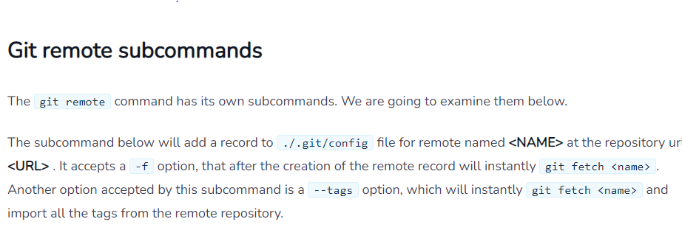

Slide 74
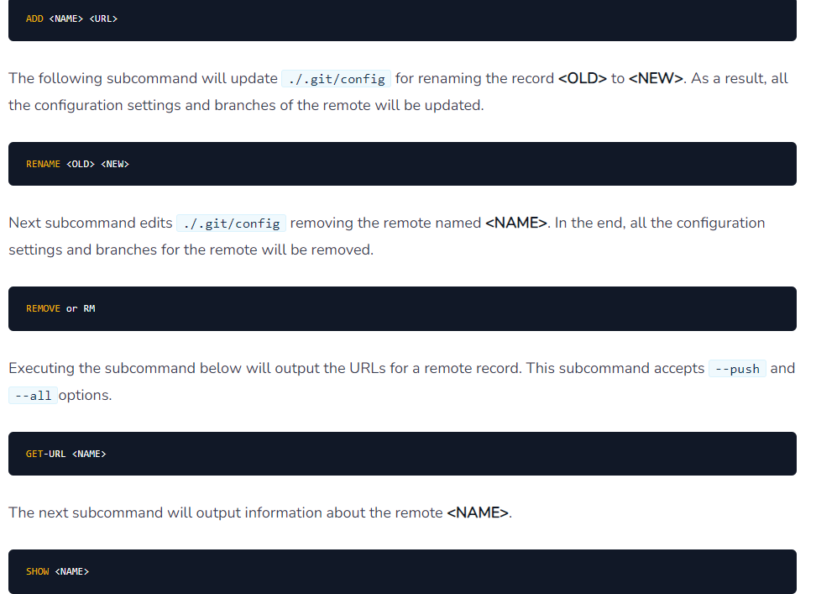

Slide 75
